Slide 1
Saliency based coding for Omnidirectional Videos
Week 3 : Bhishma Dedhia

Slide 2
Approach
Used the Boolean map based Saliency model instead of Deepgaze2 to predict 2D saliency maps.
Used the same approach as before of taking cube map projections and evaluating the saliency map of each face.
However in this case I also considered other centres to generate the cube map projections before reprojecting the Saliency maps into the same orientation as the original ERP.
Centres considered were:
Yaw | Pitch | Roll
0 | 0 | 0
45 | 0 | 0
0 | 45 | 0
0 | 0 | 45

Slide 3
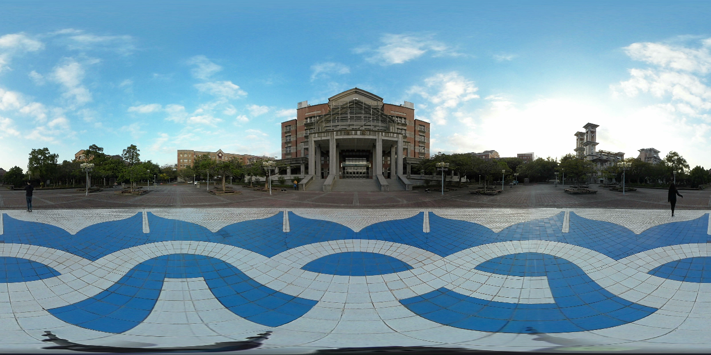
Approach
The various ERP SM generated were combined through an element-wise max( ) operation to generate a final ERP saliency map.
A Gaussian blur was operated upon the Final Saliency map to smoothen out the image and remove edges.
Testcase Input image:

Slide 4
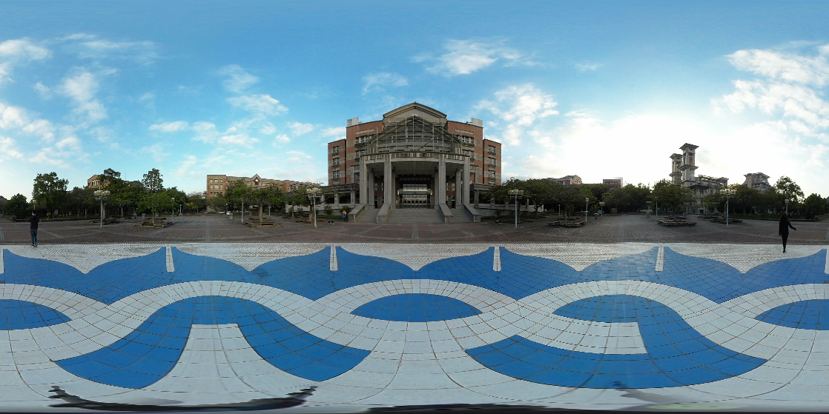
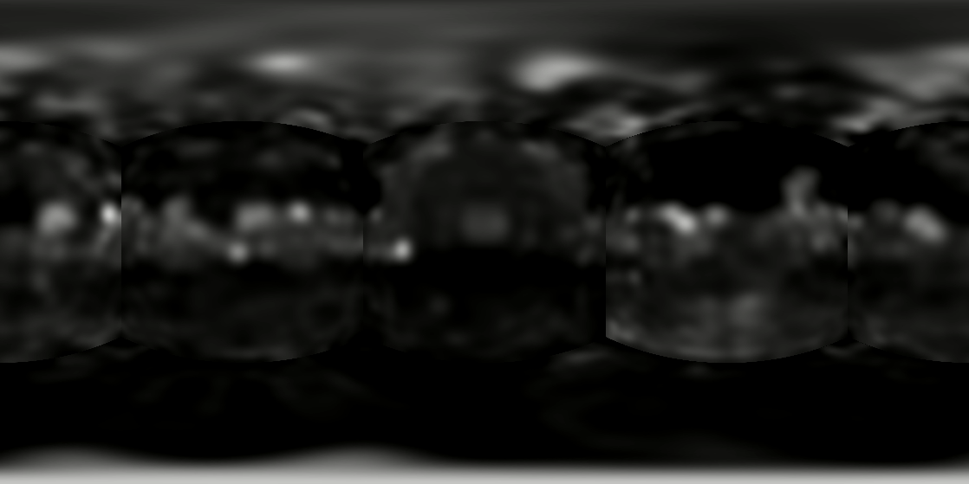
Centre = (0,0,0)

Slide 5

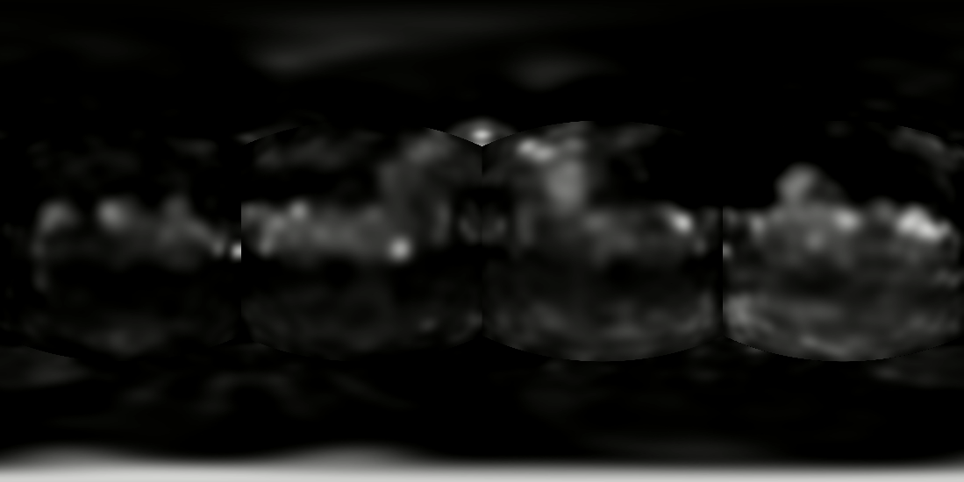
Centre = (45,0,0)

Slide 6
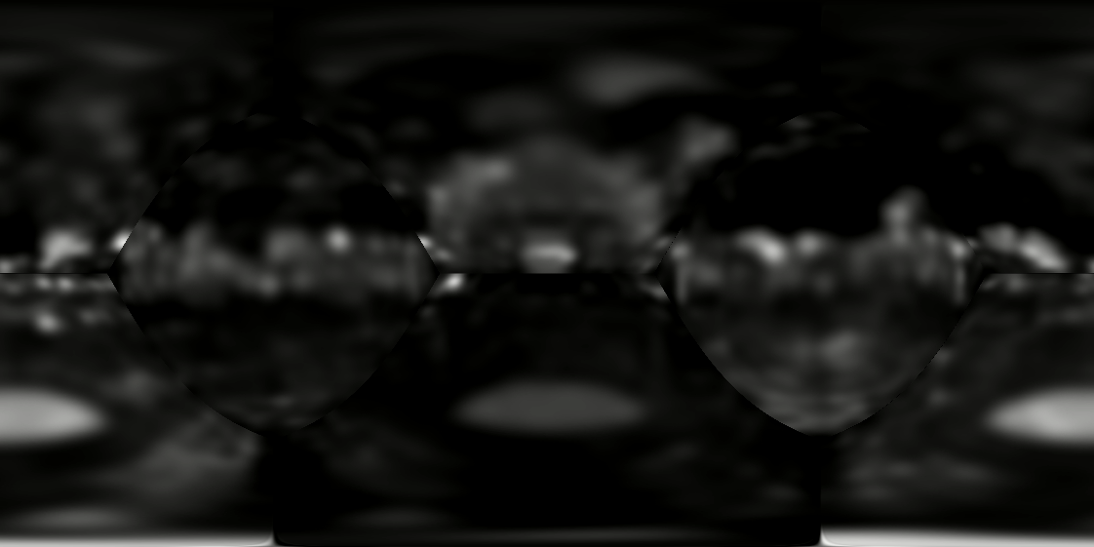
Centre = (0,45,0)

Slide 7
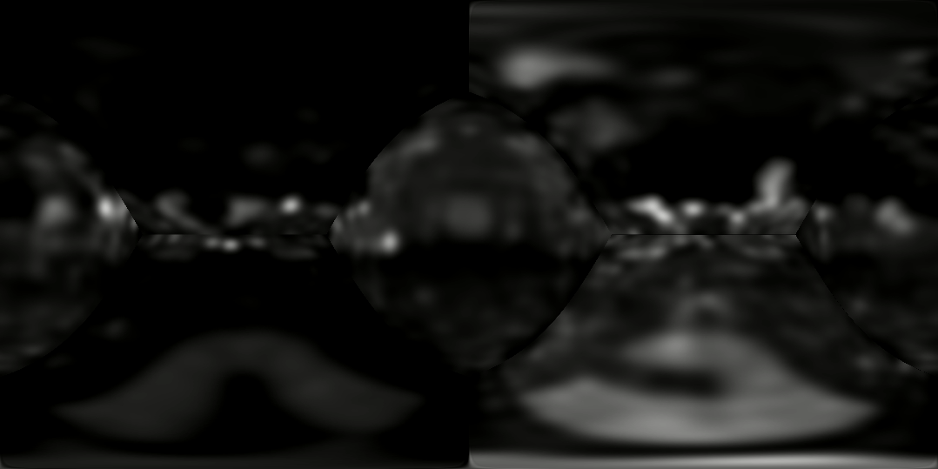
Centre = (0,0,45)

Slide 8
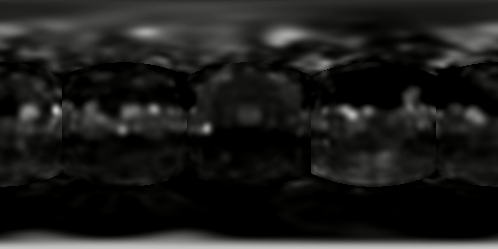

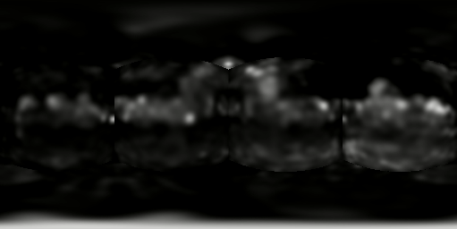
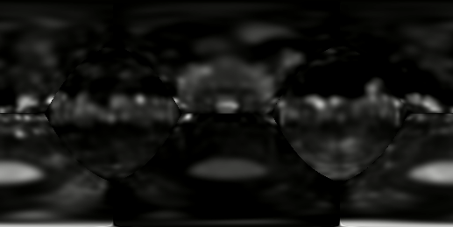
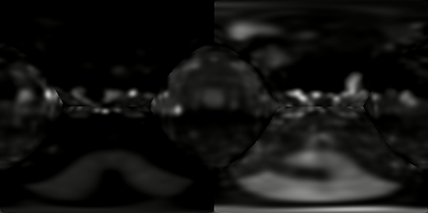
Final Saliency Map

Slide 9



Slide 10
Salient360! Dataset
What does it contain?
Head Eye Input images + Groundtruth saliency map
Evaluation metrics
Ready to use Parsing functions in Matlab

Slide 11
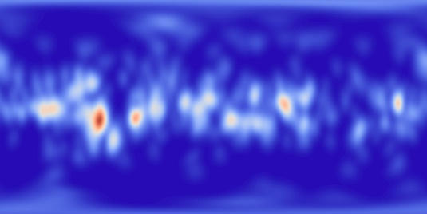
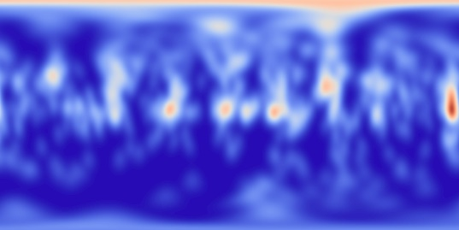
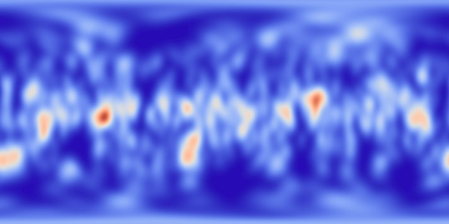
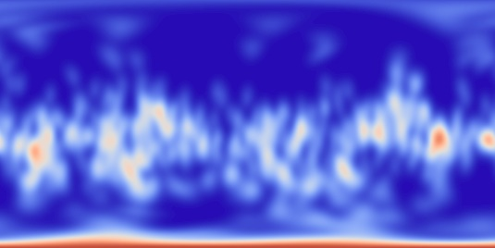
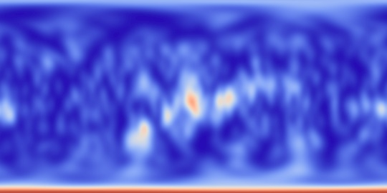
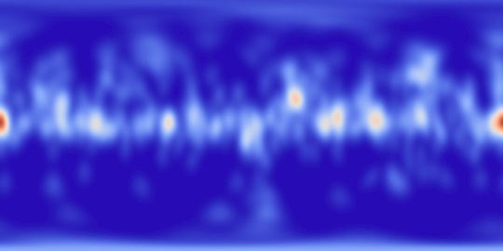
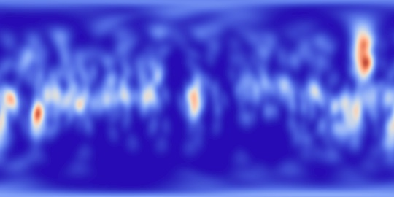
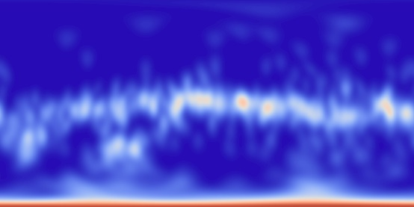
Generating Latitude bias from training data
Examples of some ground truth saliency maps (Red : High, White : Medium, Blue : Low)

Slide 12


VLIM
Map in which latitude contains average value across all longitude across all images.
Resulting Latitude bias:
RdBu color scale
Grayscale

Slide 13
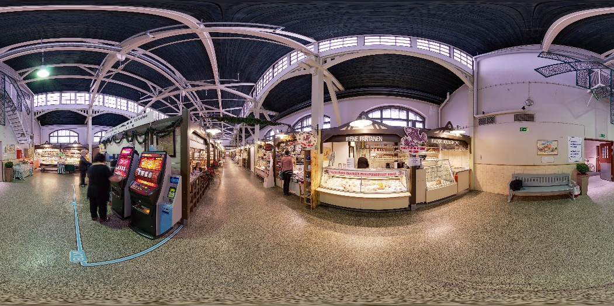

Testcase 2: Picture no. 29
Input Image
Ground truth Saliency map

Slide 14
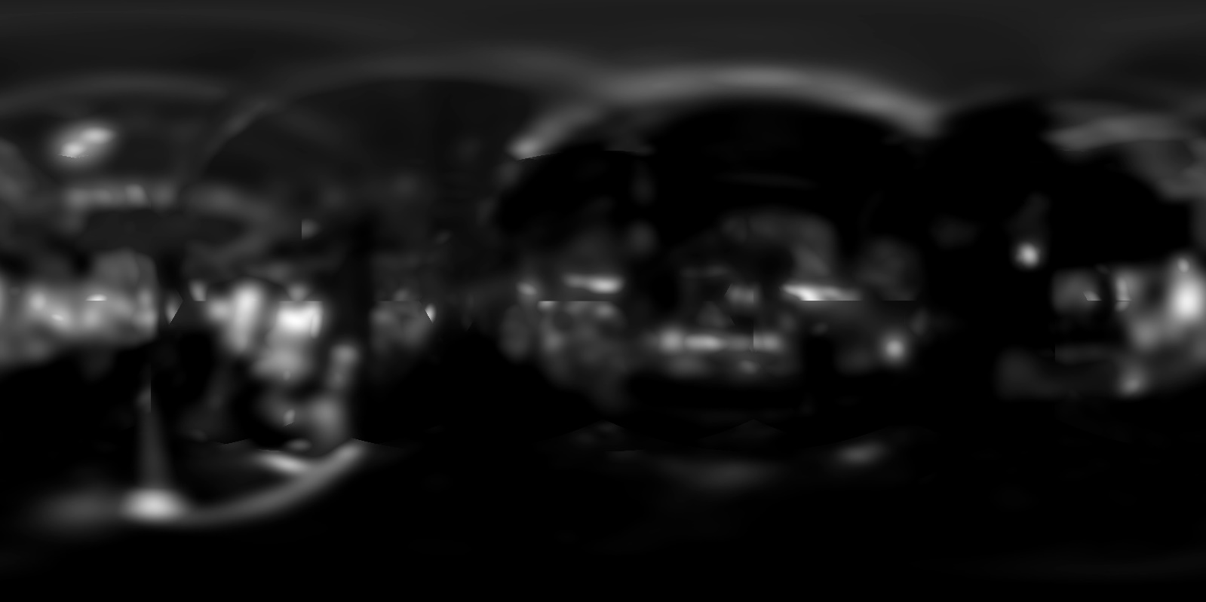
SM generated: (Without latitude bias)
Without Gaussian filter

Slide 15

SM generated: (Without latitude bias)
With Gaussian filter

Slide 16
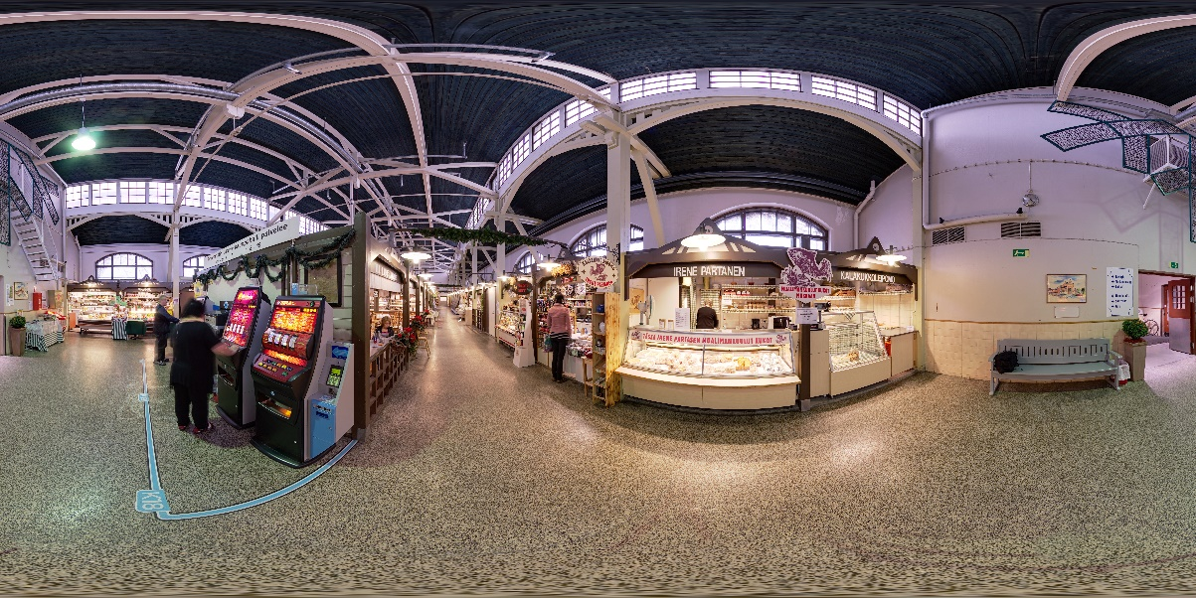

Weighted avg with VLIM: (Weight = 0.7)

Slide 17
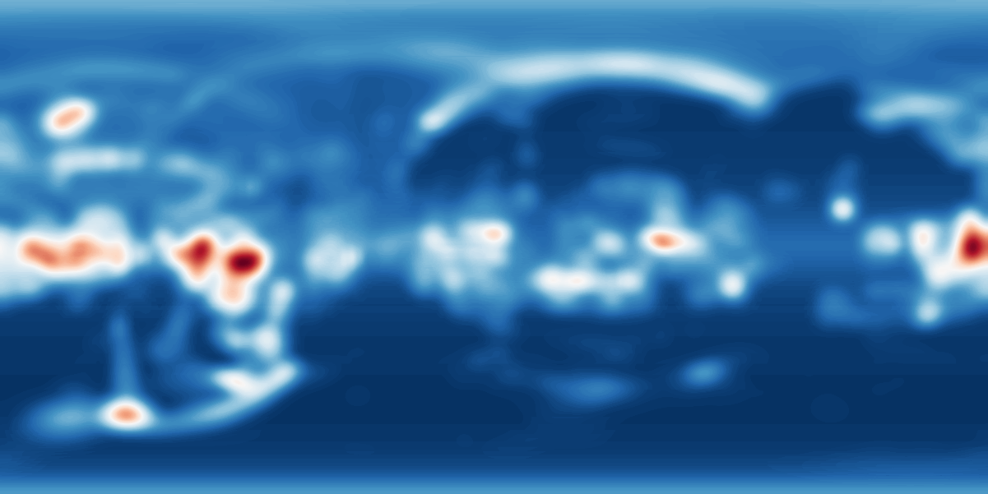

Comparison of Predicted vs Groundtruth
Predicted
Groundtruth

Slide 18
Evaluation:
Correlation Coefficient: 0.6354. Best avg score = 0.62
KLD (Kullback–Leibler divergence): 0.4909. Best avg score = 0.42.

